Slide 1
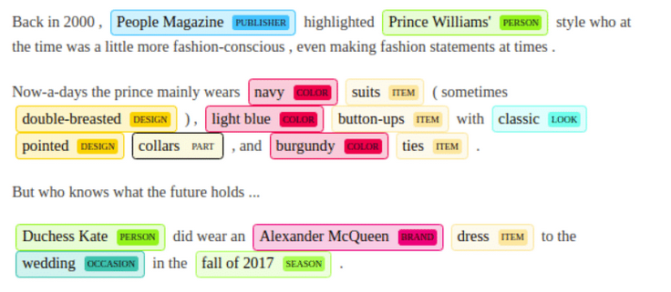
Week 5
PBA/ irma@its.ac.id
POS & NER
(Deep Dive/ Woman Who Code) https://github.com/womenwhocode

Slide 2
Week 5- GColab
PBA/ bu IH - Data scrapping article x POSTag sederhana
https://colab.research.google.com/drive/11SDPBX1o_B4vqV6PaZdwdKpmwP2QIMBH#scrollTo=2HpfF1MoMtuQ
NLP Basics - POSTag https://github.com/dwayne99/NLP-Basics/blob/master/POS%20Tagger%20/POS_tagger.ipynb
from https://github.com/dwayne99/NLP-Basics/tree/master
News Classifier BBC (next week)
https://github.com/dwayne99/NLP-Basics/blob/master/Multiclass%20classification%20of%20news/news_classifier.ipynb

Slide 3
Why Feature Engineering?
Machine learning needs numbers, not raw text
Feature Engineering = converting text into usable format
Common techniques: Bag of Words, TF-IDF, Word Embeddings

Slide 4
Syntax vs Semantics
Syntax = Grammar (how words are arranged)
Semantics = Meaning (what the sentence conveys)
Ex: "Colorless green ideas sleep furiously" (good syntax, weird meaning)

Slide 5
What is POS Tagging?
POS = Part of Speech (Noun, Verb, Adjective, etc.)
Tags each word based on its role in a sentence
Important for: Translation, Speech synthesis, Text mining

Slide 6
POS Tagging Example
Sentence: "The quick brown fox jumps."
Tags: [The/DT, quick/JJ, brown/JJ, fox/NN, jumps/VBZ]
Tools: NLTK, spaCy

Slide 7
POS Tagging Methods
Rule-based (manual rules)
Probabilistic (e.g., Hidden Markov Models)
ML-based (learns from tagged data)

Slide 8
Hidden Markov Models (HMM)
Used in probabilistic POS tagging
States = POS Tags, Observations = Words
Learns transitions between tags and emission of words

Slide 9
POS Tagging Challenges
Word ambiguity:
- "Can" = verb (I can swim) vs noun (a soda can)
Context helps determine the right tag

Slide 10
What is Chunking?
Also called Shallow Parsing
Groups related words together (e.g., Noun Phrases)
Example: "[The little yellow dog] [barked] [at the cat]"

Slide 11
What is Named Entity Recognition (NER)?
Finds specific *real-world* entities: names, places, dates
Example: "Barack Obama was born in Hawaii" → [Person], [Location]

Slide 12
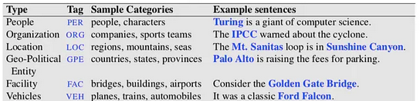
Read:
https://medium.com/data-science-in-your-pocket/named-entity-recognition-ner-using-conditional-random-fields-in-nlp-3660df22e95c

Slide 13
NER Steps
1. Detect an entity
2. Extract the phrase
3. Categorize (Person, Location, etc.)

Slide 14
NER Methods
Lexicon-based: lookup dictionaries
Rule-based: handcrafted patterns
Machine Learning: learns from annotated data

Slide 15
N-Grams (Bonus)
N-Gram = sequence of N words
Example: Bi-gram of "I love NLP" → ["I love", "love NLP"]
Used in text prediction and language models

Slide 16
Summary
POS Tagging = Labeling words
NER = Extracting named entities
Both are essential for understanding text

Slide 17
Tools to Try
Try NLTK or spaCy in Google Colab
Practice tagging sentences and finding entities

Slide 18
Resources
Luis Serrano HMM Video
FreeCodeCamp: POS & HMM
AnalyticsVidhya: Dependency Trees
TowardsDataScience: N-Grams

